Slide 1
PySpark Integration
S3 and MySQL

Slide 2
Agenda
Why we need Integration.
Apache Spark Integration.
What is ETL.
PySpark Integration with S3
PySpark Integration with Database (MySQL).
Implementation of PySpark Integration.

Slide 3
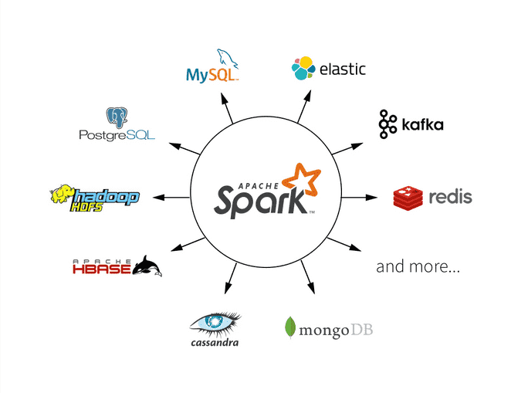
Apache Spark Integration
What is Integration.
Read write data from Anywhere.
Easy to integrate with Hadoop tools.
  Like Hive, Hbase etc
Easy to integrate with Cloud Platform.
  Like AWS, GCP and Azure

Slide 4
Why we need Integration with Spark
To make faster data Processing.
Some technology does not work like spark technology.
Spark is a popular technology for big data processing.
Sometimes we need to process petabytes of data but data is stored in a particular server. When we process data on that server here it will take lot of time. In that case we need to integration with spark to fast data processing.
Eg. Hadoop process data in 100 min but when we integrate spark with Hadoop then it will take to process data in 10 min.

Slide 5
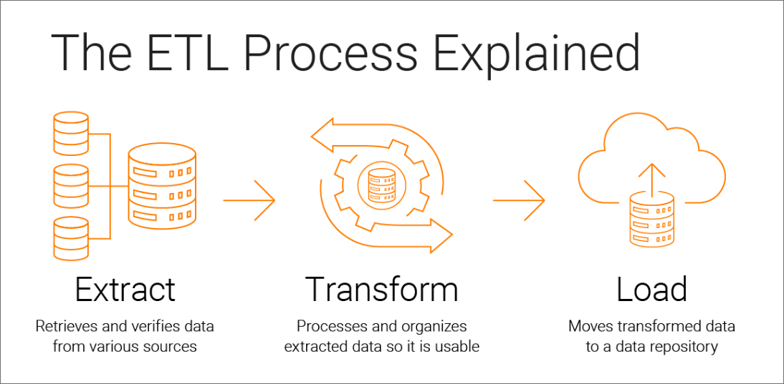
Extract, Transform and Load (ETL)
ETL is used for data Pipeline.
Extract:-
  Extract data from servers, database, etc.
Transformation:
  Transform extracted data from the source.
Load:
  Ingest transformed data to the destination.

Slide 6

Learn About S3
Amazon S3 is easy-to-use object storage with a simple web service interface that you can use to store and retrieve any amount of data from anywhere on the web.
It is used for Backup and archive for on-premises or cloud data Content, media, and software storage and distribution
How to use S3
  Create Buckets:-
    Create and name a bucket that stores data.
  Store data in Buckets:-
    Store an infinite amount of data in a bucket. Upload as many objects as you like into an Amazon S3 bucket.

Slide 7
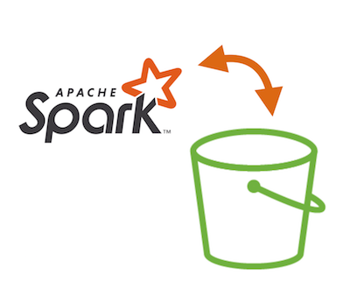
PySpark Integration with S3
S3 stored different kinds of data in buckets from various data sources that’s why data is in huge amounts.
Easy to integrate with spark.
We need to Integrate Spark with S3 to fast data processing.
Using spark easy to read and write data from s3.
In spark we need to create DataFrame from external data source S3.

Slide 8

Learn About MySQL
MySQL is the most popular Open Source Relational SQL database management system that helps users store, organize, and retrieve data.
A database is an application that stores a collection of data from various sources.
It has the features like
  Creating the Database
  Creating the Tables
  Store data in structure form in tables.
  update, delete, modify and search data in MySQL tables

Slide 9

PySpark Integration with Database (MySQL).
MySQL stored structured data in tables in huge amounts.
To read data from MySQL Database we need to integrate spark.
Easy to integrate MySQL with PySpark.
Collect data from the database as per required data.
Easy to read-write data from MySQL using spark.
Different ways to integrate spark with some other databases.
  Like SQL Server, MongoDb, Hbase etc

Slide 10
Implementation of PySpark Integration
Start integration with S3
Start Integration with MySQL.

